Slide 1
Demo 2 Presentation
Group 13 - FarmFriend

Slide 2
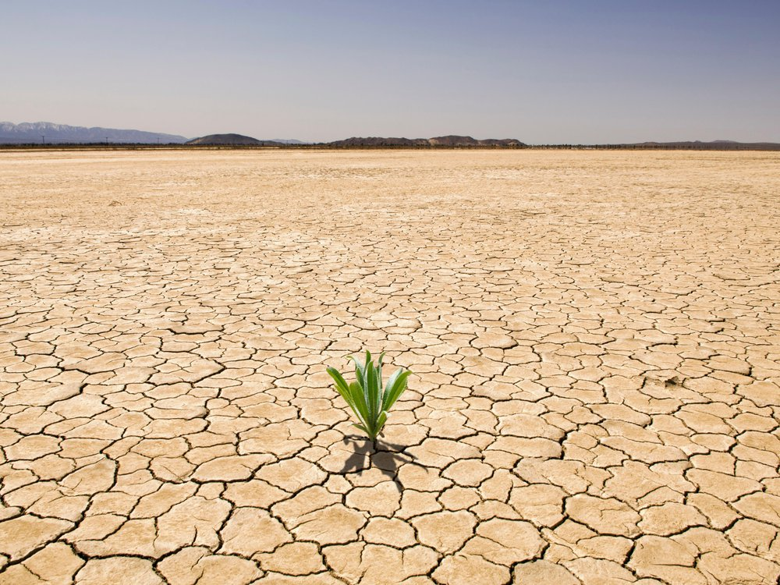
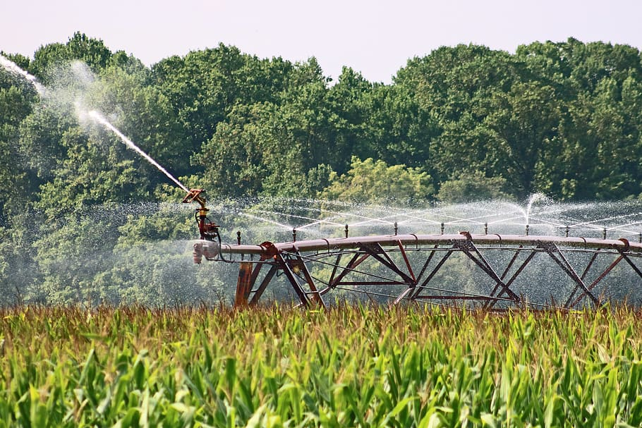

12,000,000
Hectares of land are lost annually due to drought and desertification
https://www.syngenta.com/en/innovation-agriculture/challenges-modern-agriculture
Notes:
https://www.syngenta.com/en/innovation-agriculture/challenges-modern-agriculture

Slide 3

Introduction
The FarmFriend robotic system monitors soil health, and can act to varying levels of pH by stabilising soil to a pH that is most optimal for the crop being grown.

Slide 4
Project process
Reactive
Web App
Component to react to different soil pH levels
Analytics from the data collected
Sensors
Navigation
Components to take soil measurements
Autonomous navigation of the system

Slide 5
Table of contents
Value Proposition
Overview
01
02
Progress
Demonstration
03
04
Summary and motivation behind the project
How the system is envisioned to be used
Technical progress made thus far
Physical functional demonstration of the robot

Slide 6
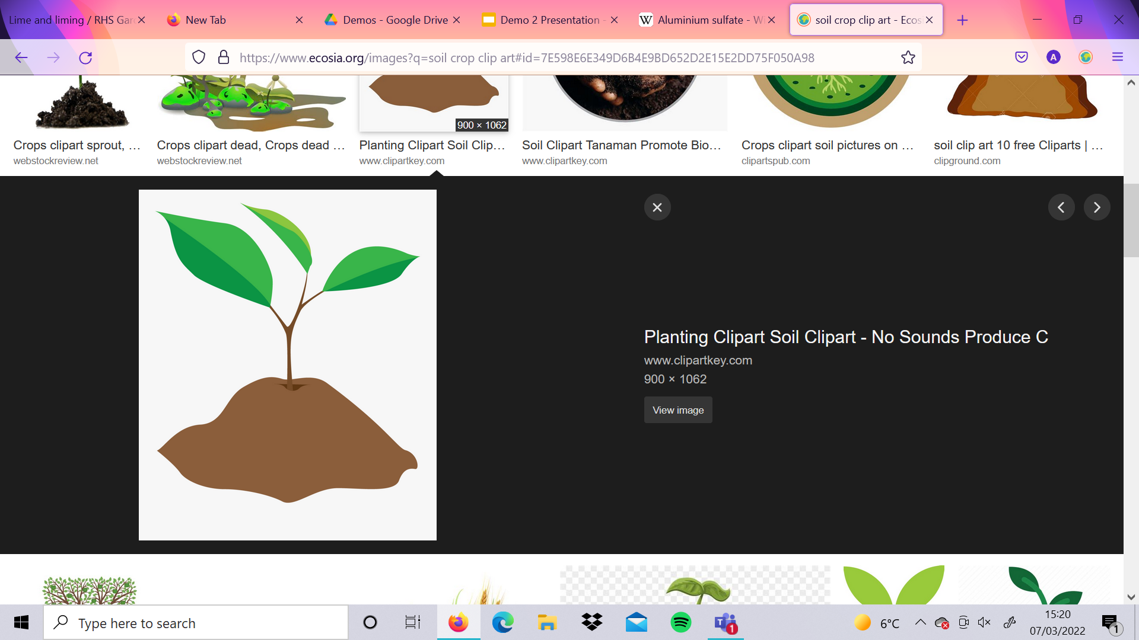
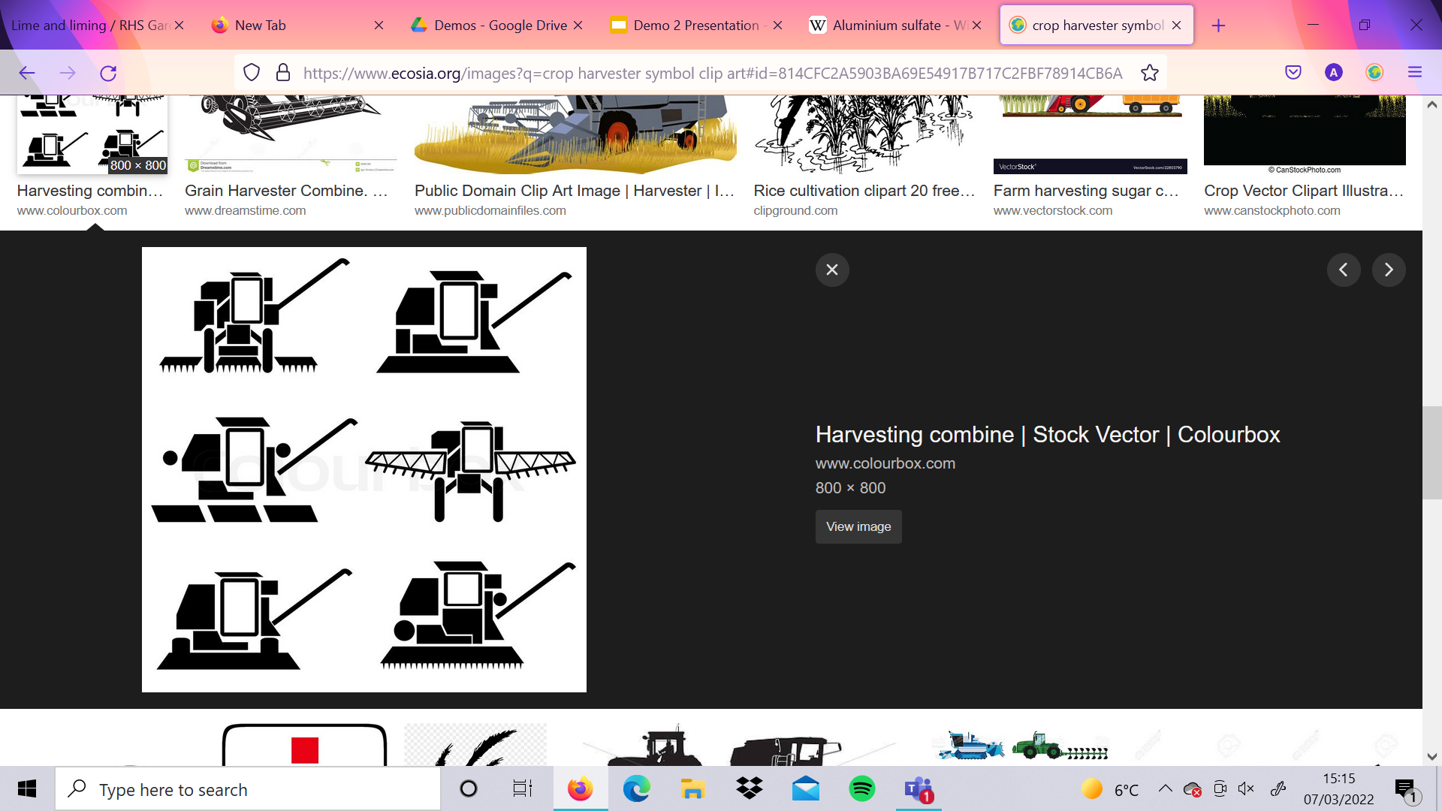
WHY REACTIVE
Farmers Treat Field
Soil pH Changes
FarmFriend Makes Micro-Adjustments
Notes:
Farmers treat their fields indiscriminately before a new crop to get the soil to average to an optimal pH. The soil then changes pH due to a number of factors, like weather (which is getting more extreme due to climate change) or other chemical treatments. We propose a reactive system that makes micro adjustments based on localised field data to return small parts of the field into the optimal range. Thus we can store concentrated compounds which can alter pH with only small amounts.

Slide 7
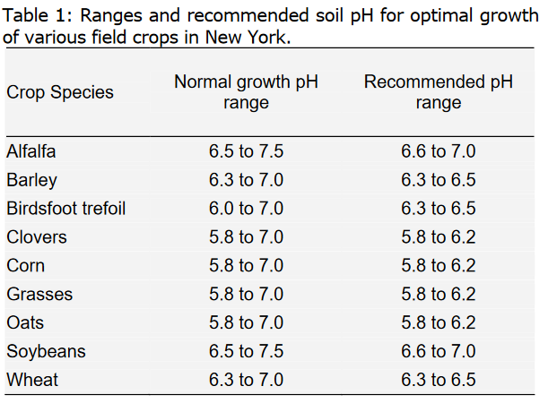
http://cceonondaga.org/resources/soil-ph-for-field-crops
Notes:
We envision the pH stabilising component to be modular, exchangeable to cater for other nutrients, such as potassium. This further business opportunities with nutrient providers to meet towards sustainable agriculture goals. Ph was chosen to be measured because a recent survey of arable soils in the UK showed that more than 40% have a soil pH less than the optimum level of 6.5. (Holland, 2019). As we can see above, many soil pH ranges are not in the recommended range. This would be solved by regular cheap data collection.(http://cceonondaga.org/resources/soil-ph-for-field-crops)

Slide 8
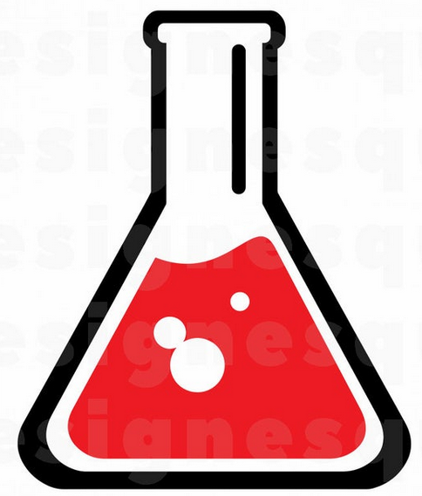
ACIDIFIER
Aluminum Sulfate
0.54 kg/m² per 1 pH
Lower soil by 0.1 under FarmFriend requires 35 grams
Clemson University
https://hgic.clemson.edu/factsheet/changing-the-ph-of-your-soil/

Slide 9
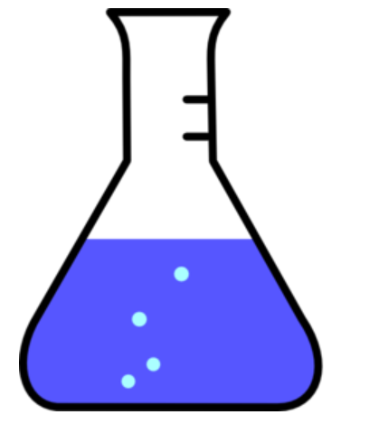
Base
Lime
1 kg/m² per 1 pH for Clay
0.8 kg/m² per 1 pH for Loam
0.7 kg/m² per 1 pH for Sand
Royal Horticultural Society,
https://www.rhs.org.uk/soil-composts-mulches/lime-liming

Slide 10
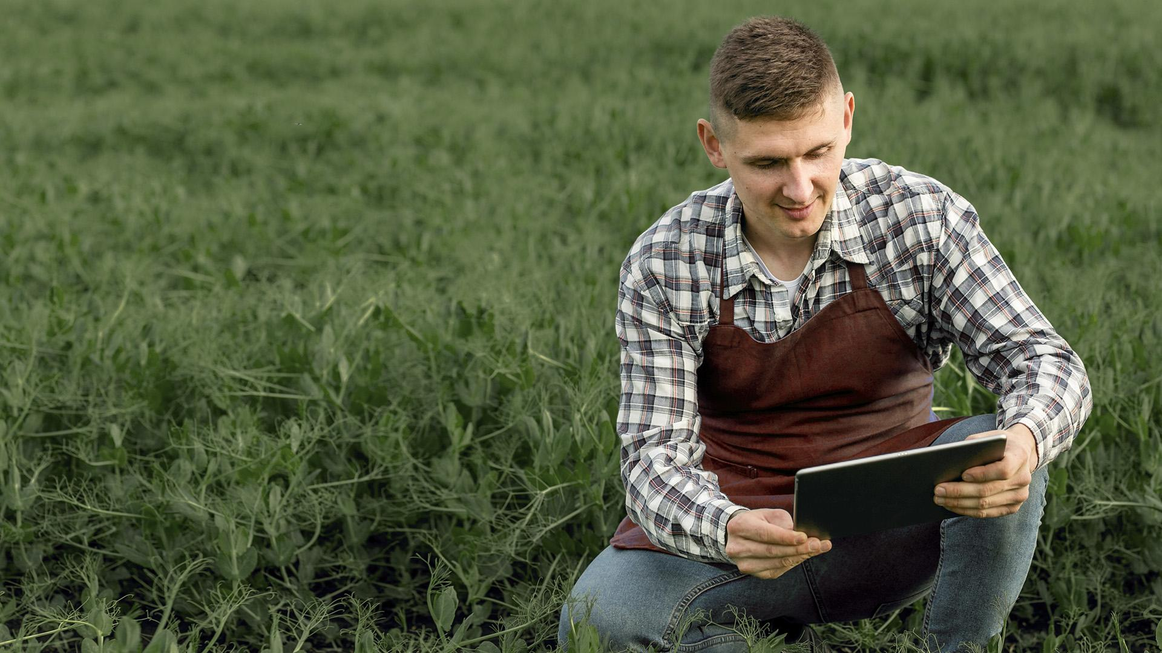
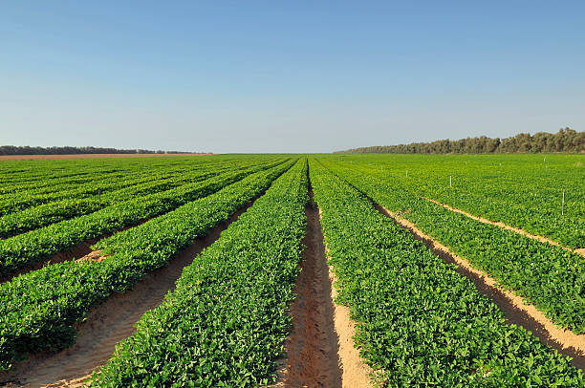
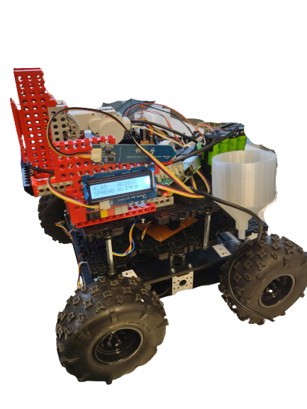
Segmentation of the field
Navigate
Sense
React
Notes:
The robotic system will be able to autonomously navigate through a given field, gathering and up loading data to a web application which displays key statistics to the user; this allows farmers to attend to other work while crops are being measured, then view and make use of the data when needed.

Slide 11
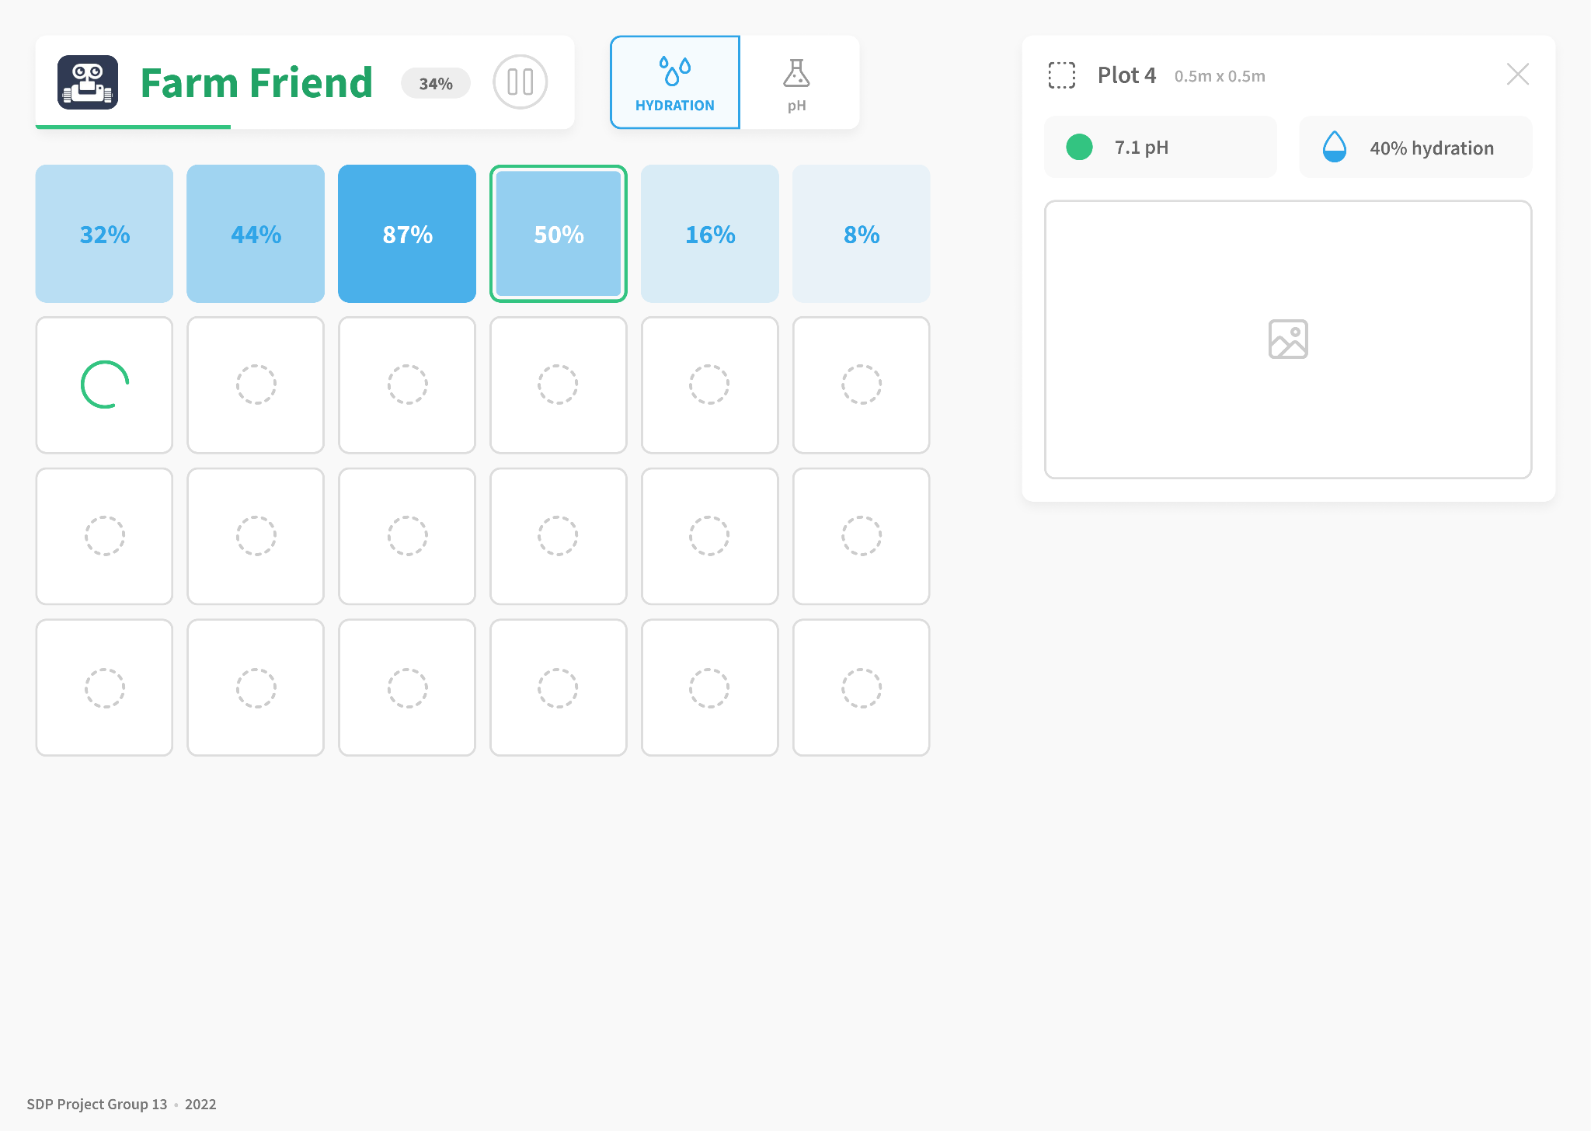
Web App MVP

Slide 12
01
Value Proposition
Why is there a market?

Slide 13
Who would use it?
Farmers
Nutrient providers
Our primary user, monitoring soil health
Reactive element fitted with nutrients
Optimising the productivity of individual plants through smart precision farming.

Slide 14
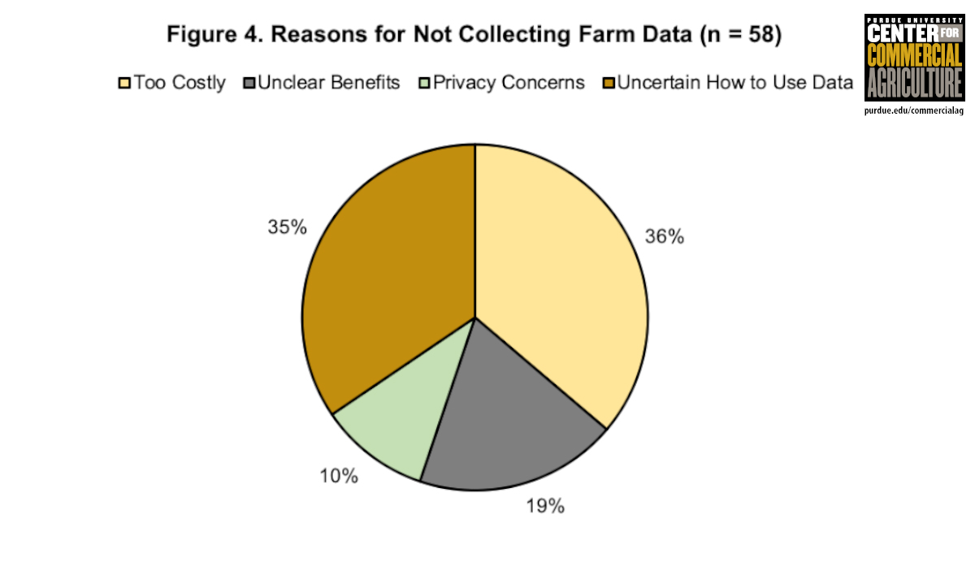
https://www.sciencedirect.com/science/article/pii/S1573521418302616
Notes:
According to (Nathan DeLay, 2020), 38% of farmers surveyed believed data collection too costly, and 35% were unaware of how to use the data effectively. This shows a large market gap for our system, as an affordable alternative to more expensive solutions. With the web app we can present the understandable data to the user allowing them to see exactly which part of their field is not optimal.

Slide 15
Why not IoT?
“Agriculture margins make tech investment tough.”
How can farmers maintain IoT themselves?
Average cost of IoT infrastructure
IoT is complex
$500 /acre
https://readwrite.com/iot-agriculture-costs-it4/
Notes:
https://readwrite.com/iot-agriculture-costs-it4/

Slide 16
02
System Overview
How does it work?

Slide 17



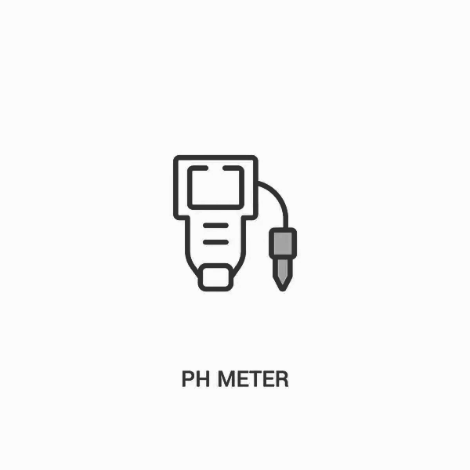
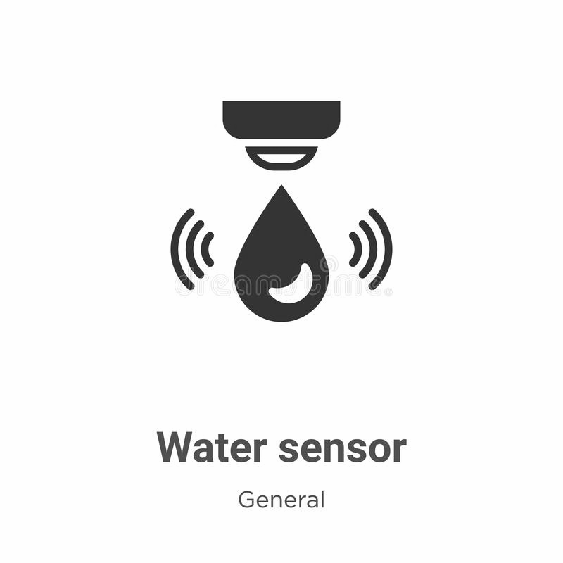
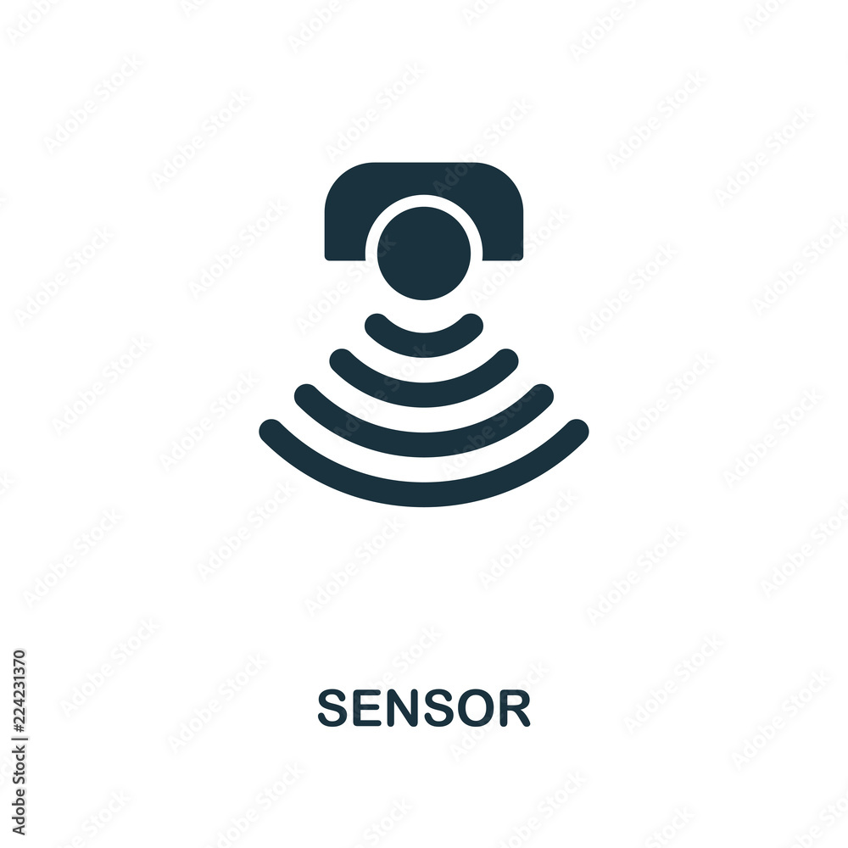


System Overview
DICE
DICE
RASPBERRY PI
RASPBERRY PI
Prowler
Prowler
Rotary Encoders
Reactive Motors
Notes:
We chose the prowler for its larger wider wheels, which provides a larger surface area to distribute the weight of the chassis onto; which means that we are able to minimise the damage to the crops.
The prowler base is also significantly more powerful as compared to the standard turtlebot; however it brings more challenges such as having our own wheel encoders and navigation system.
As opposed to a Raspberry Pi to control the sensor motor, we use an Arduino. This allowed us to modularise the development and since the moisture sensor is an arduino component it kept the entire sensor sequence in one place. Another reason is that it is easier using Arduino because there are off the shelf libraries, and in the case of Pi we need to write more complicated codes to achieve the same purpose.
The system is mounted on the prowler chassis
It is controlled using a Raspberry Pi, which communicates with the four motors for the wheels and the Arduino which currently controls the sensor system.
We use a DICE machine to control the Pi to run a script which starts the sequence
An Arduino controls a motor which turns a wheel to lower/lift the moisture sensor and the sensor itself is connected to the Arduino. A display shows the moisture reading (higher -> dryer).

Slide 18
03
Technical Progress
What have we accomplished?

Slide 19
Technical Progress
One of the arduinos can move the sensor motor, control the motor to rotate the spreader & operate LEDs (representing valves)
A mount for the reactive motor and the gear “box”.
A more complicated control script that can react to pH inputs, calculate amounts of material to deposit

Slide 20
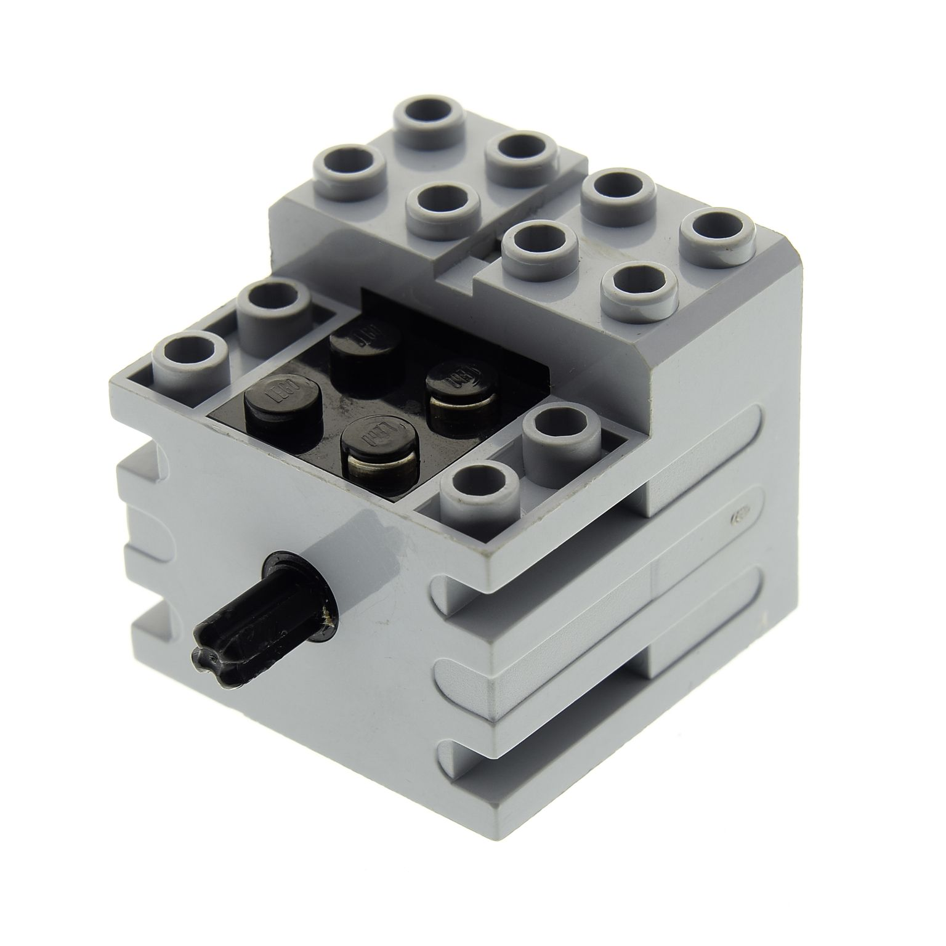
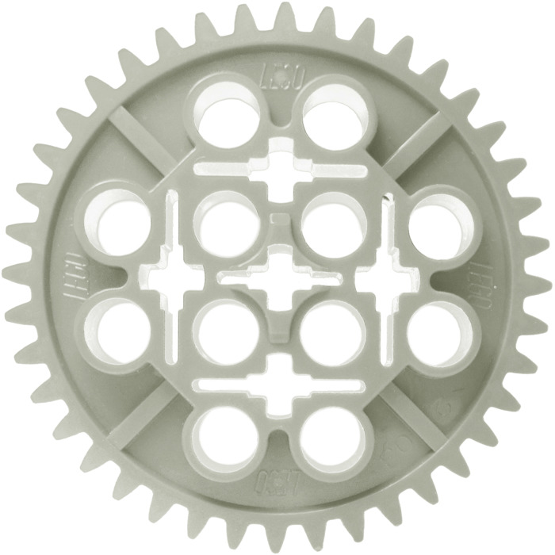
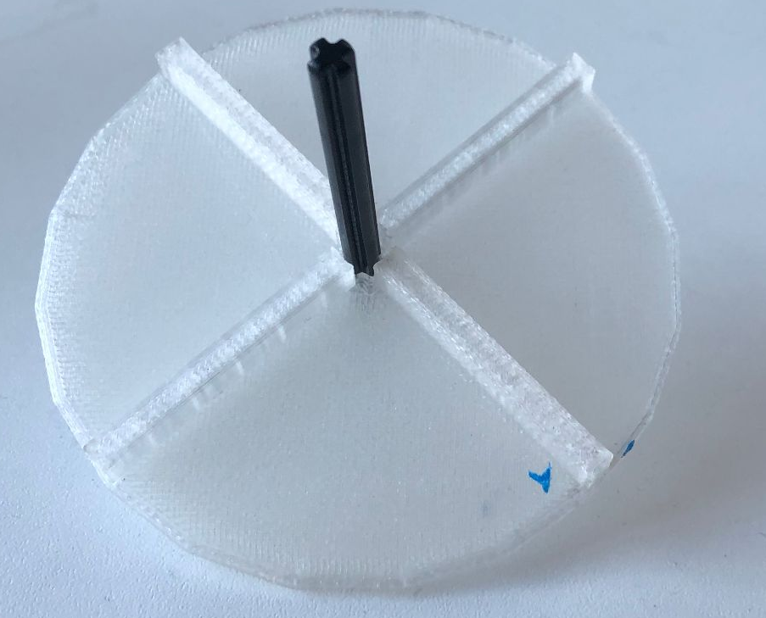
Reactive Motor & Spreader
DC Motor
Lego Gear Sequence
Rotary Spreader
Notes:
A single motor to control the spreader
The spreader has a lego axle through it, and we use a gearbox to turn it a high speeds
Communicates with Pi to allow spreading whilst FarmFriend is moving
Rotation provides rotational velocity to powder
Moves it towards a side (vertical components)
Powder meets side and is pushed out

Slide 21
Tanks, Tubing & Valves
2 tanks for each substance, made of cylinder and funnel
Tubing to be connected
Solenoids valves used to open and close, gravity pulls out substance
Deposited onto spreader
Currently represented by LED

Slide 22
Reactive program
Check Serial Port
Motor Drives sensor down
Moisture sensor detects moisture level
Report Result to LCD Screen
Motor to raise sensor
Randomise pH data
Report if too acidic/basic to LCD Screen
Calculate amount required to adjust soil
Report Amount
Turn on LED light corresponding to acid/base
Turn on Spreader

Slide 23



Progress addressing demo 1 feedback
Web app
Sys arch
Control Feedback
Front end of the web app complete
Migrated our system to ROS
Allowed by use of wheel encoders

Slide 24
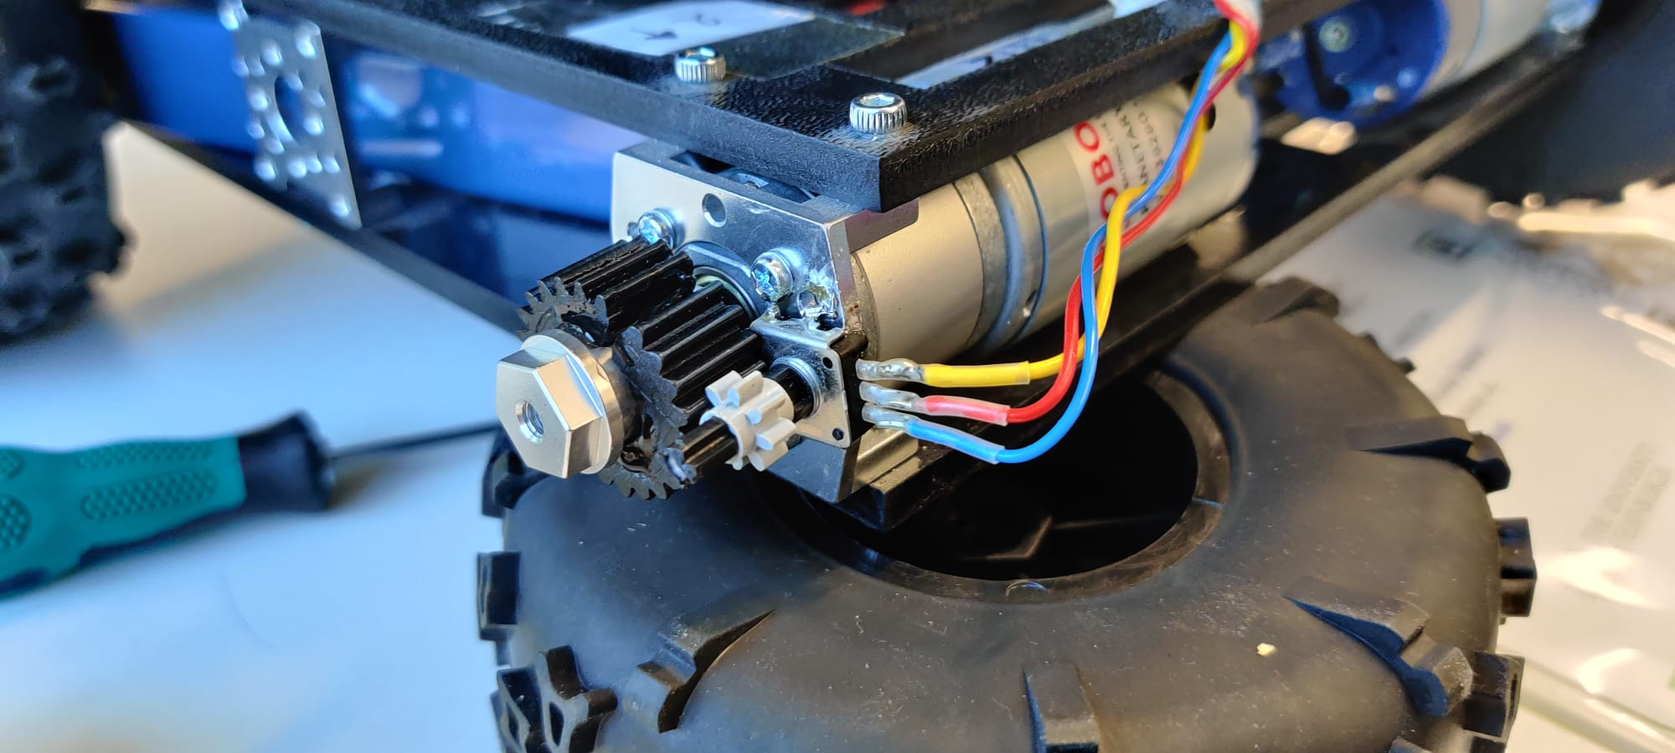
Control feedback (rotary encoder)

Slide 25
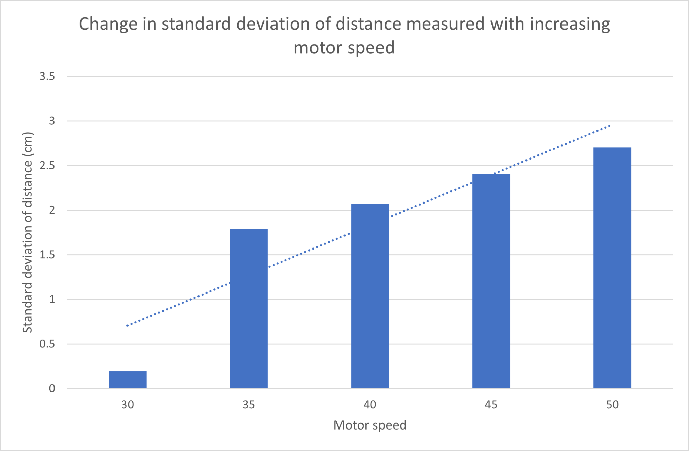
Control feedback (rotary encoder)

Slide 26
04
System Demo
Let’s see it working!

Slide 27
Questions?

